Slide 1
THE
MILKY WAY

Slide 2
What is it ?
Where is it ?
The Sense of it all . . .

Slide 3
But Wait . . . . .
Why the Milky Way ?

Slide 4
One summer night . . .
Far off on a distant armadillo field
there arose such a chatter that I sprang to the heavens to see what might be there . . .
and what I heard and what I saw gave new meaning to the objects above . . .

Slide 5
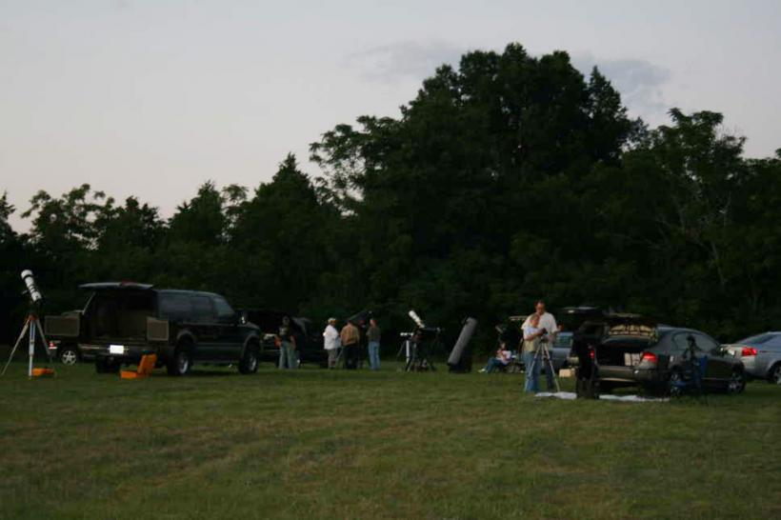
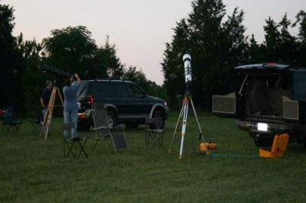
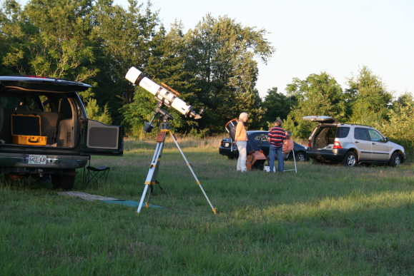
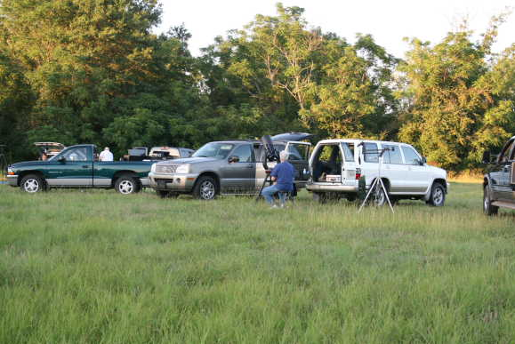
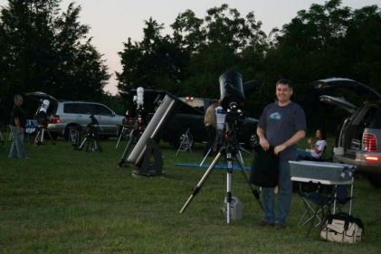
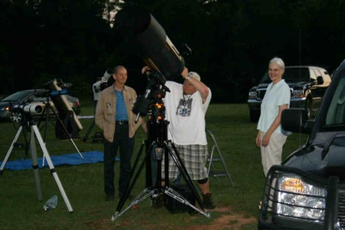
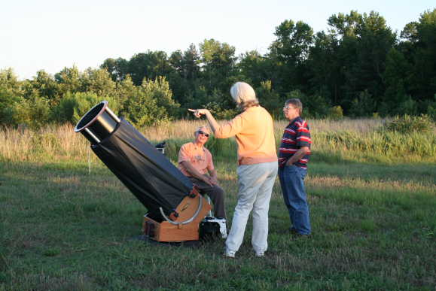
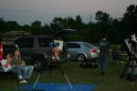
Double
Stars
Saturn
Jupiter
Star Clusters
Galaxies
Nebulas
Sun
Globular Clusters
Venus

Slide 6
M19
M16
M31
M51
M104
M42
M20
M97
M40
M63
M2
M23
M57
M6
M3
M64
M76
M44
M90

Slide 7
M19
M16
M31
M51
M19
M19
M104
M16
M16
M42
M31
M31
M20
Double
Stars
Double
Stars
Double
Stars
Saturn
M97
Saturn
M51
M51
Saturn
M104
M104
M40
M63
M42
Jupiter
M42
M20
M2
Jupiter
Jupiter
M20
M97
M97
Star Clusters
M23
Star Clusters
Star Clusters
Galaxies
Nebulas
Nebulas
Galaxies
M40
M6
M3
M40
M57
Nebulas
M63
M63
Galaxies
M2
M2
M23
M23
M64
Globular Clusters
Globular Clusters
Venus
Venus
M76
M6
M57
M6
M44
M3
M3
M90
M57
Globular Clusters
Venus
M64
M64
M76
M76
M44
M44
M90
M90

Slide 8
. . . When, what to my wondering eyes should appear,
But a miniature sleigh, and eight tiny reindeer,

Slide 9
. . . When, what to my wondering eyes should appear,
But a miniature sleigh, and eight tiny reindeer,
But a teapot, and eight billion stars
called the . . .

Slide 10
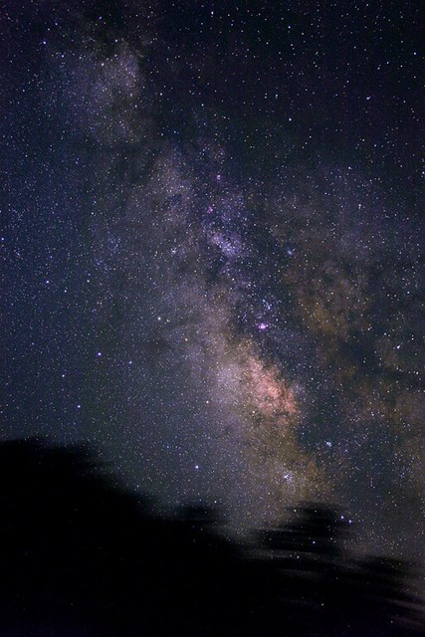
Milky Way

Slide 11
WHAT IS IT ?

Slide 12
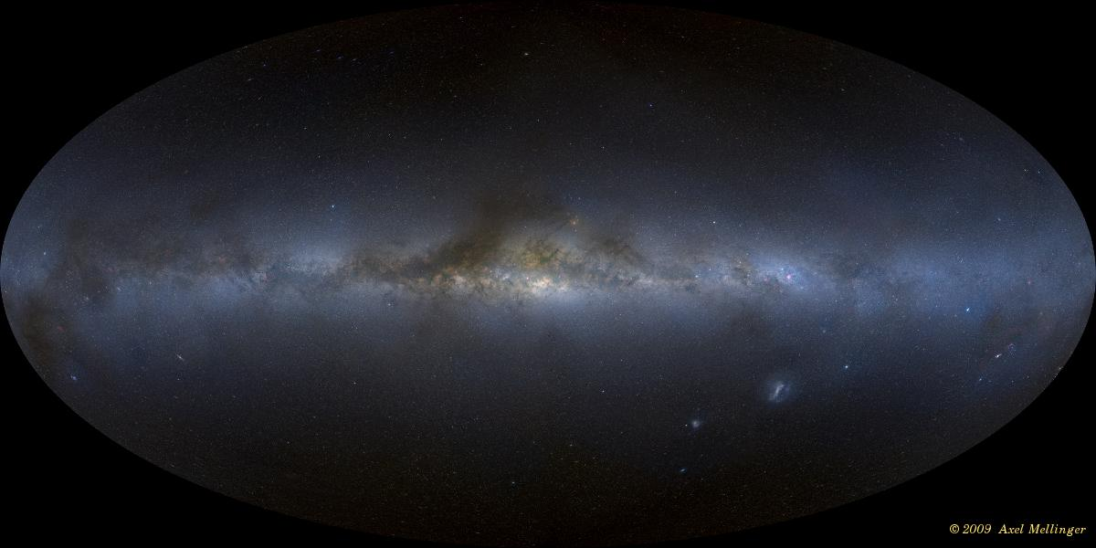
The Word ‘Milky Way’
- English translation of the Latin word Via Lactea
Translation from Greek word Γαλαξίας, Galaxias, - derived from the word for milk (γάλα, gala) - referring to the pale band of light seen as the galactic plane and/or Galaxias Kyklos "Milky Circle“ (myth)
Spanish/Portuguese - "The Road to Santiago“
Norwegian/Icelandic - "The Winter Way“
Lithuanian /Latvian - “The Birds' Path”
Chinese - "Silver River"
Japanese - "River of Heaven"
Central Asia to Africa – “The Straw Way”
First appeared in English literature in a poem by Chaucer

Slide 13
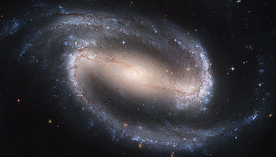
Barred Spiral Galaxy
The Local Group (comprises 30 galaxies with its gravitational center located between the Milky Way and the Andromeda Galaxy)
Approximately 100,000 light-years in diameter
About 1,000 light-years (9.5×10¹⁵ km) thick
Contains at least 200 – 400 billion stars
Rotational speed is about 157.82 mph
Age is estimated at 6.5 - 10.1 billion years (Based on the formation of the galactic thin disk through the UV-Visual Echelle Spectrograph of the ‘Very Large Telescope’)

Slide 14
Structure is a bar-shaped core region surrounded by a disk of gas, dust & stars
Forms four two distinct logarithmic spiral arms
Most of mass is thought to be dark matter (Hypothetical matter undetectable by its emitted radiation, but presence is inferred from gravitational effects on visible matter)
Galactic center harbors a compact object of very large mass (Intense radio source of Sagittarius A* center mark is newly confirmed to be a supermassive black hole)
One of billions of galaxies in the observable universe

Slide 15
So,
what does it look like . . .

Slide 17
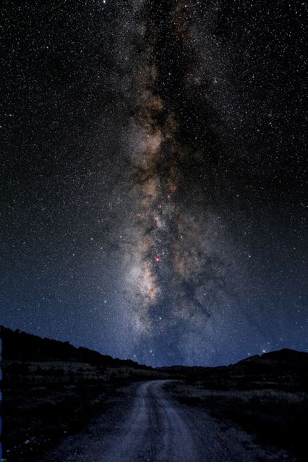

Slide 18
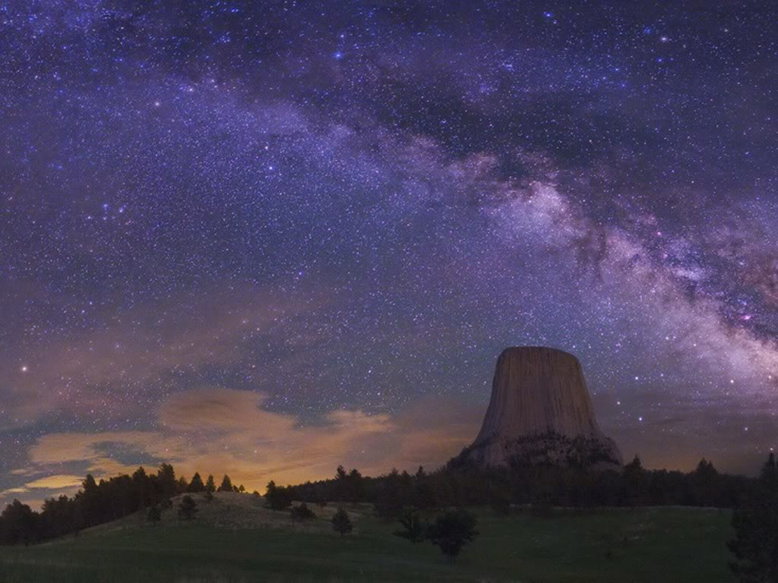

Slide 19
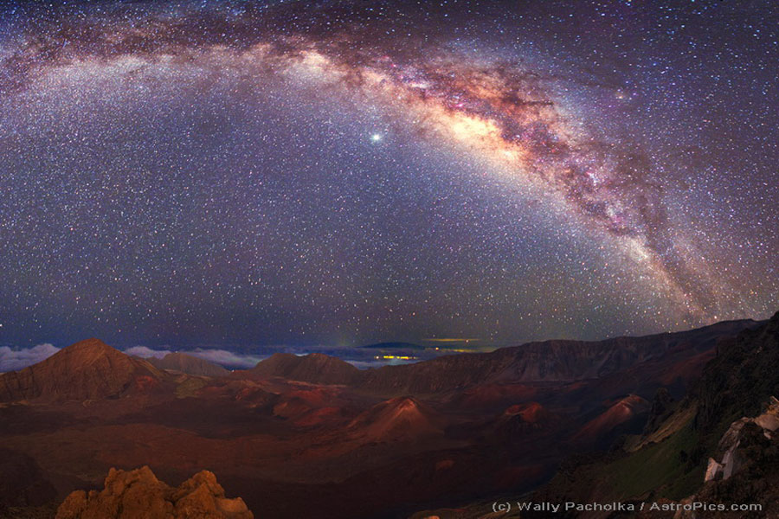

Slide 20
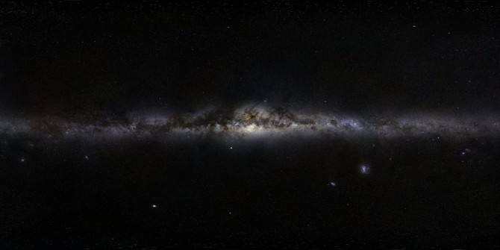

Slide 21
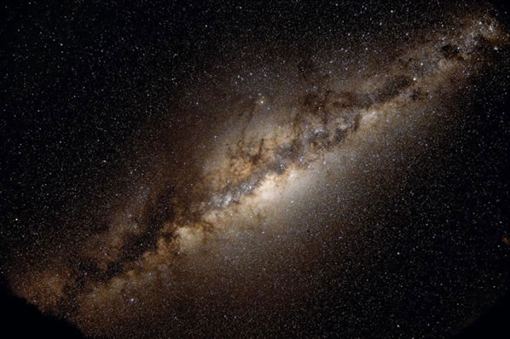

Slide 22
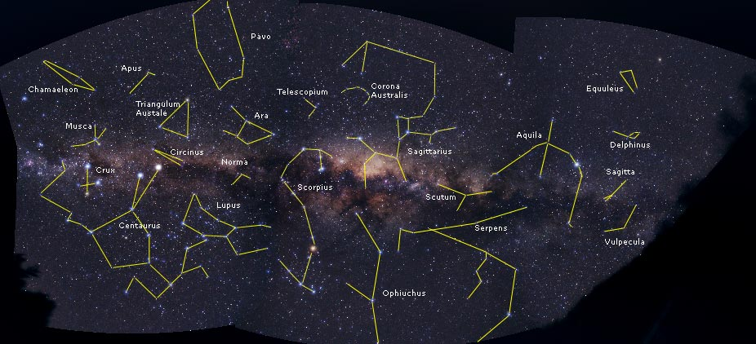

Slide 23
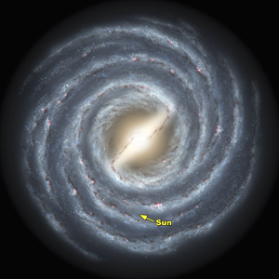
The Old . . .
4 Major Arms
- Scutum-Centaurus
- Sagittarius
- Norma
- Perseus

Slide 24
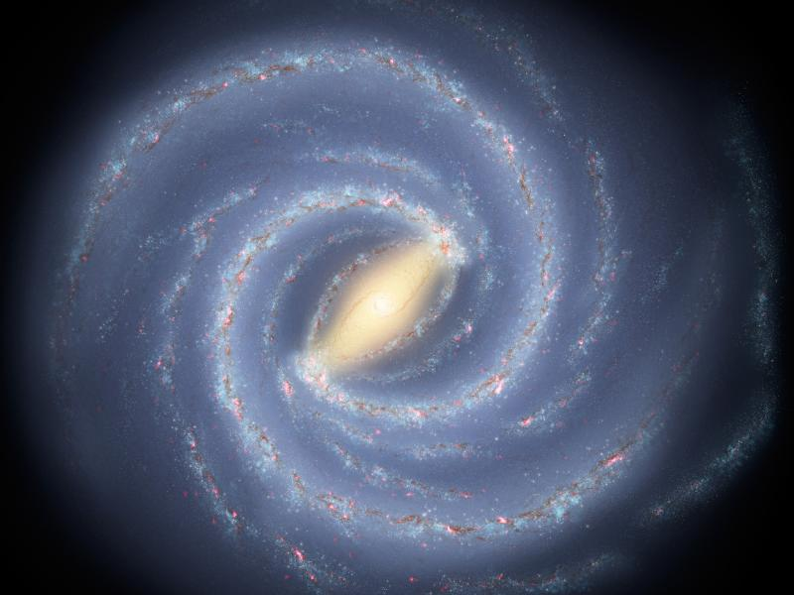
The New . . .
2 Major Arms
- Scutum-Centaurus
- Perseus

Slide 25
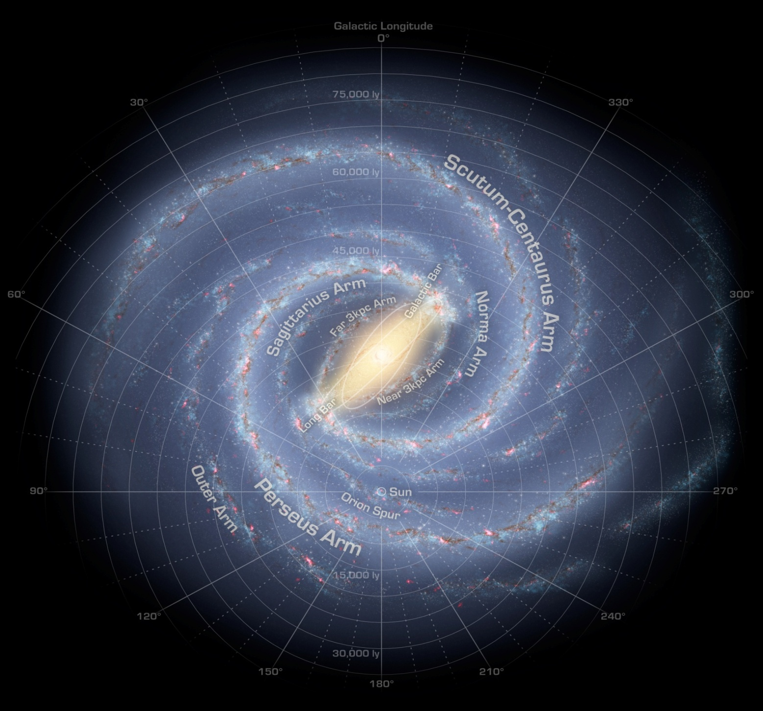

Slide 26
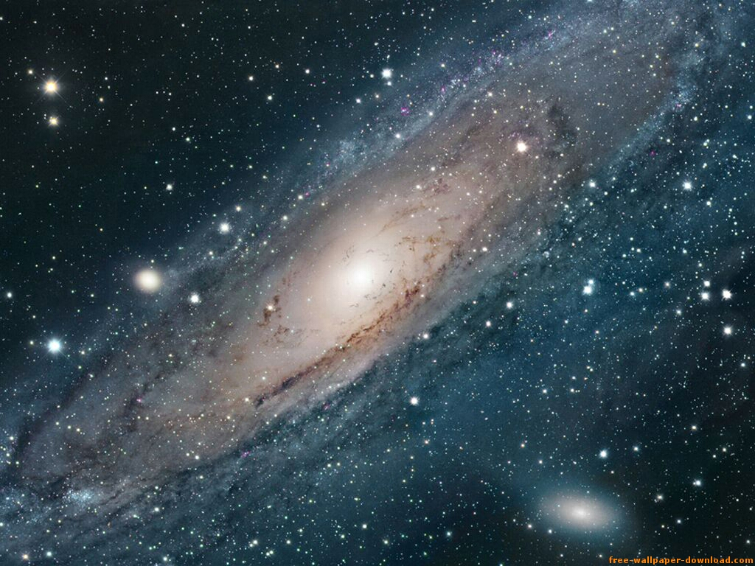

Slide 27
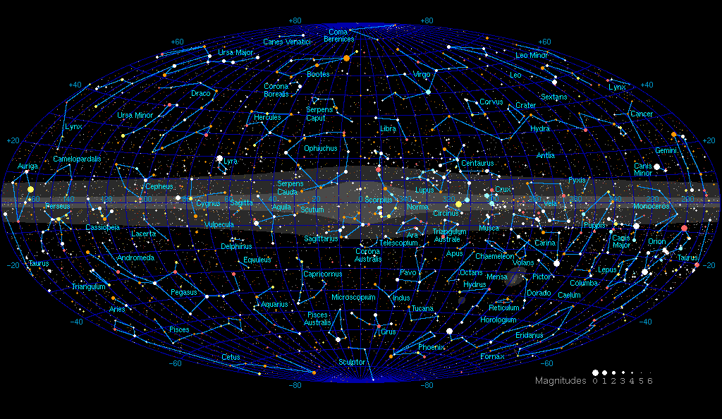
This map is a plot of all the stars visible with the naked eye. There are approximately 9000 stars visible with the naked eye. This map is plotted in galactic coordinates - the plane of the Milky Way galaxy passes across the middle of this chart with the zero point of galactic latitude and longitude pointing directly at the galactic centre. The majority of the stars plotted on this map are within a thousand light years from us, which is only a minute part (less than 0.1%) of our galaxy, although there are a few naked eye stars which are probably beyond ten thousand light years. All of the 88 constellations have also been marked onto this map although constellations have no real significance - all constellations consist of stars that lie at very different distances.

Slide 28
Where is it . . .

Slide 30
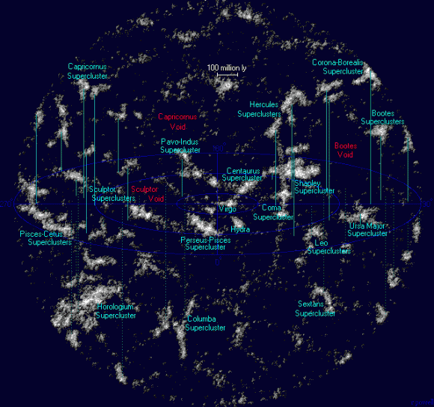
Map of the Universe

Slide 31
What you saw . . .
What you saw on the preceding page is a map of the Universe within 1 billion light years. It shows the Virgo Supercluster at the center and its neighboring superclusters, clusters, and voids. The white clouds are the superclusters and clusters while the vast black areas are the voids.
Superclusters, one of the largest structures in the Universe are each home to clumps of galaxies known as galaxy groups and clusters. Galaxy groups are composed of up to 50 galaxies, while clusters can contain thousands.
The Virgo Supercluster (Virgo SC) is also known as the Local Supercluster (LSC or LS), simply because it is where our very own Milky Way Galaxy and immediate neighbor Andromeda belong.
How large of an area does this image span?
The Virgo Supercluster, at the center, is about 100 million light years wide; just one-tenths of this map. Our Milky Way, long believed to be the entire universe until Edwin Hubble pointed out nebulae far outside the borders of our galaxy, has a diameter of only 100,000 light years. Finally, our Solar System is believed to be only 2 light years wide.

Slide 32
Map of the Universe

Slide 33
The Sense of it all . . .

Slide 34
. . . a different perspective

Slide 35
There are . . .
6,951,884,284 people on earth (as of 6:00 AM this morning)
2, 249, 501 Cities
194 Countries
7 Continents
5 Oceans

Slide 36
There are . . .
6,951,884,284 Stars (as of 6:00 AM this morning)
2, 249, 501 Suns, Planets, & Moons
194 Galaxies
7 Superclusters
5 Areas of Black Matter

Slide 37
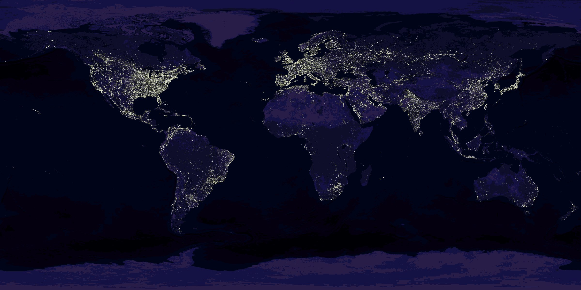
At night it all looks like this . . .

Slide 38
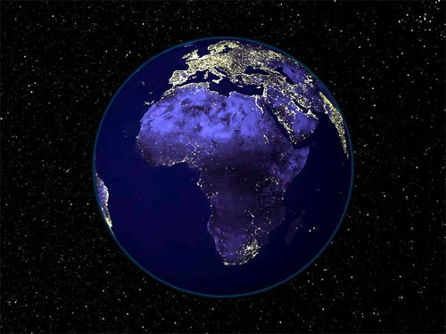
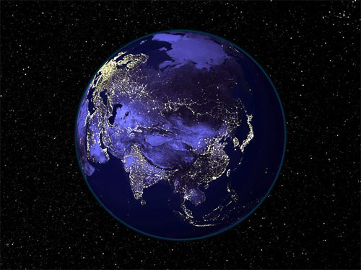
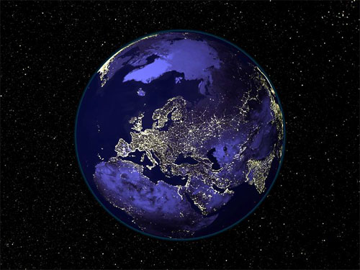
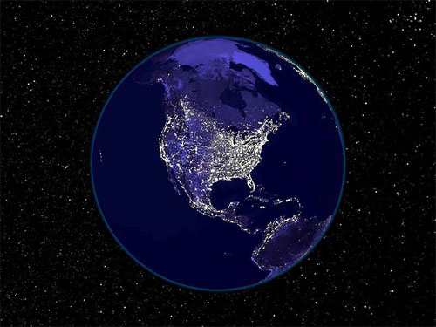
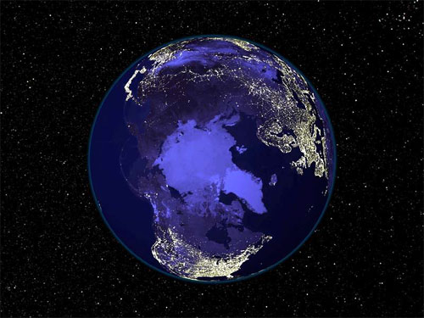
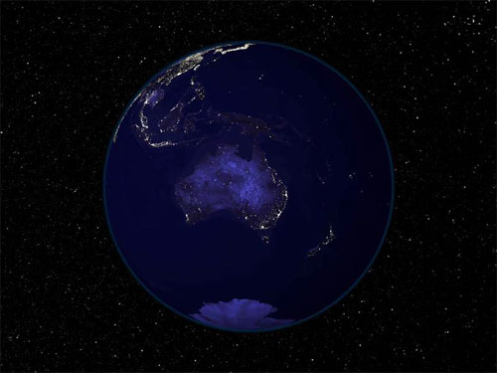
and this . . .

Slide 39
or like this . . .

Slide 40
or like this . . .

